Slide 1
Introduction to Digital Image Analysis
Kurt Thorn
NIC

Slide 2
Bitdepth
Digital cameras have a specified bitdepth = number of gray levels they can record
8-bit → 2⁸ = 256 gray levels
10-bit → 2¹⁰ = 1024 gray levels
12-bit → 2¹² = 4096 gray levels
14-bit → 2¹⁴ = 16384 gray levels
16-bit → 2¹⁶ = 65536 gray levels

Slide 3
Bitdepth and file formats
Standard imaging formats, like tiff, are always 8 or 16 bit (because 8 bits = 1 byte)
16 bit value (0-65535)
0
0
0
0
12 bit data (0-4095)
0
0
0
0
12 bit data (0-65535)
but counting by 16s

Slide 4
Color Images
Color images are made up of three gray scale images, one for each of red, green, and blue
Can be 8 or 16 bits per channel

Slide 5
File Formats
Most portable: TIFF
8 or 16-bit, lossless, supports grayscale or RGB
OK: JPEG2000, custom formats (nd2, ids, zvi, lsm, etc.)
Lossless, supports full bitdepth
Custom formats often support multidimensional images
Not so portable
Bad: Jpeg, GIF, BMP, etc.
Lossy and / or 8-bit

Slide 6
Intensity scaling
Computer screens are 8-bit
Publishers also want 8-bit files
255
Final Intensity
0
0
4095
Original Intensity
You lose information in this process –
values 4080-4095 all end up as 255

Slide 7
Intensity scaling
Max
255
Contrast
Final Intensity
Brightness
0
0
4095
Original Intensity
Min

Slide 8
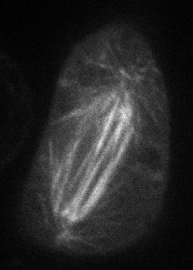

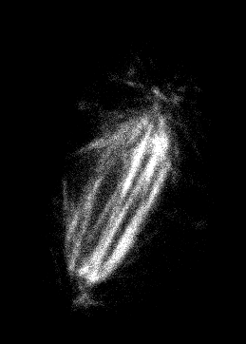
Effect of scaling
Scaled to min / max
(874 / 25438)
(874 / 19200)
(6400 / 18432)
Drosophila S2 cell with mCherry-tubulin (Nico Stuurman)

Slide 9
Gamma correction
γ=0.45
Output Intensity
γ=2.2
γ=1
Input Intensity
Other contrast stretching transforms….

Slide 10
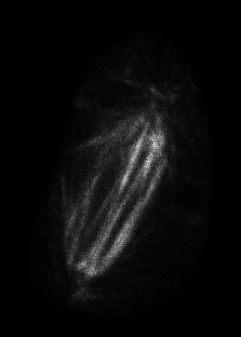
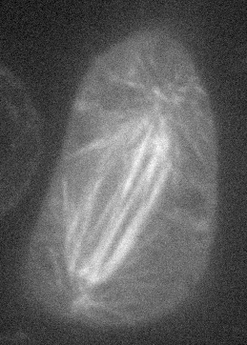
Effect of gamma
Scaled to min / max
(874 / 25438), γ = 1
Scaled to min / max
(874 / 25438), γ = 2.16
Scaled to min / max
(874 / 25438), γ = 0.45

Slide 11
What are acceptable image manipulations?
JCB has the best guidelines
http://jcb.rupress.org/misc/ifora.shtml#image_aquisition
http://jcb.rupress.org/cgi/content/full/166/1/1
Brightness and contrast adjustments ok, so long as done over whole image and don’t obscure or eliminate background
Nonlinear adjustments (like gamma) must be disclosed
No cutting and pasting of regions within an image (e.g. individual cells)

Slide 12
Background correction
Cameras have a non-zero offset
There can also be background fluorescence due to media autofluorescence, etc.
Want to correct for this by background subtraction
Camera dark image
Estimate background from image

Slide 13
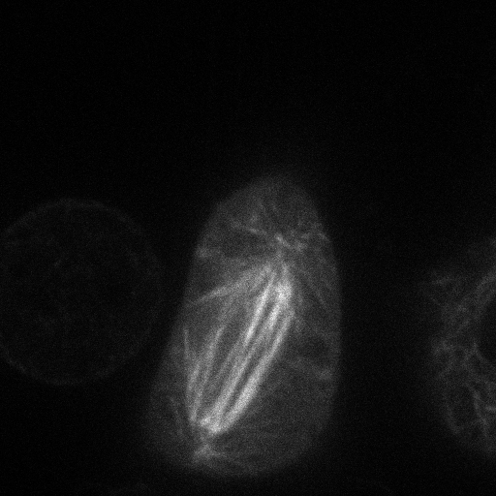
Estimating background from image
Number
Pixel Intensity

Slide 14
Dark image
Acquired with no light going to the camera
Allows you to measure instrument background
Can detect what’s real background autofluorescence

Slide 15
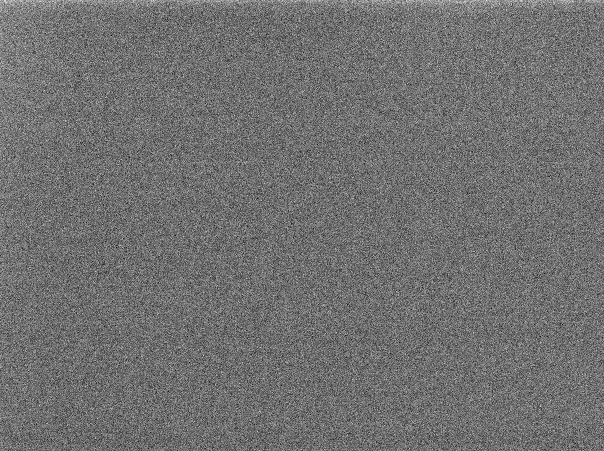
Dark image

Slide 16
Shading correction
Measure and correct for nonuniformity in illumination and detection
Image a uniform fluorescent sample

Slide 17
Shading correction

Slide 18
Correction procedure
I_{meas} = I_{true} * Shading + Dark
I_{true} = (I_{meas} – Dark) / Shading
Good to do on all images

Slide 19
More formally…
I(x,y) = F(x,y) * Ex(x,y) * Det(x,y) + Dark(x,y)
If no photobleaching, then Shading = Ex(x,y)*Det(x,y) is a good approximation
Fluorophore distribution
Excitation Intensity distribution
Detection efficiency

Slide 20
If photobleaching…
I(x,y) = (F(x,y) / k*Ex(x,y)) * [1-exp(-k*Ex(x,y)*t)] * Det(x,y) + Dark(x,y)
Yuck
If you have significant photobleaching and significant excitation non-uniformity, shading correction breaks down
Can actually lead to contrast inversion (!)

Slide 21
Measuring Excitation and Detection Distributions
Take photobleaching time-series on uniform thin-film of fluorophore
Photobleaching rate at each pixel gives intensity
Variance not explained by intensity distribution gives detector sensitivity distribution
Zweir et al. 2004, Ghauharali et al. 1998,1999

Slide 22
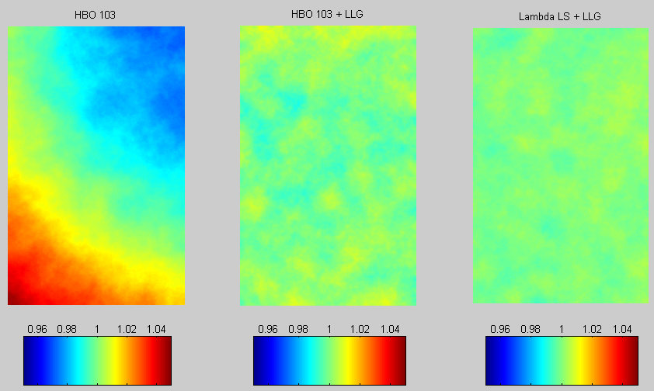
Illumination Uniformity

Slide 23
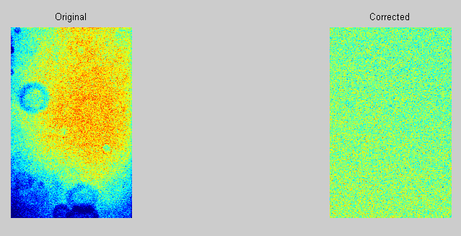
Correcting
Once excitation distribution is relatively flat, correction for detector distribution is once again linear.

Slide 24
Back to digital image analysis
Filtering
1 | 1 | 1
1 | 1 | 1
1 | 1 | 1
Averaging / Smoothing
0 | 1 | 2 | 1 | 0
1 | 6 | 10 | 6 | 1
2 | 10 | 16 | 10 | 2
1 | 6 | 10 | 6 | 1
0 | 1 | 2 | 1 | 0
Gaussian smoothing

Slide 25
How this works
1 | 1 | 1
1 | 1 | 1
1 | 1 | 1
(10+11+22+13+8+10+20+20+15)/9 = 14
10
+11
+22
Multiply corresponding pixels and sum
10 | 11 | 22 | 5 | 7
13 | 8 | 10 | 5 | 24
20 | 20 | 15 | 23 | 14
0 | 3 | 17 | 15 | 8
7 | 11 | 6 | 15 | 12
14

Slide 26
Why smooth?
If your image is sampled appropriately (at Nyquist) the point spread function will be spread out over multiple pixels
Properly exploiting this redundancy requires deconvolution
But smoothing helps
Also reduces single pixel noise artifacts that can’t be real

Slide 27
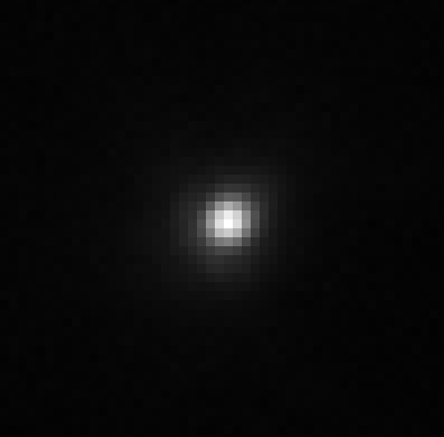
Actual PSF

Slide 28
Why smooth?
Averages redundancy and suppresses noise
10 photons/pixel average
5 e- read noise
Gaussian smoothing filter, σ = 1 pixel

Slide 29
Smoothing
Original
Gaussian filtered, σ = 0.6

Slide 30
Other filters
Edge Detection
1 | 1 | 1
0 | 0 | 0
-1 | -1 | -1
1 | 2 | 1
0 | 0 | 0
-1 | -2 | -1

Slide 31
Edge Detection
Original
Horizontal edge detection

Slide 32
Other filters
Unsharp masking
-1 | -4 | -1
-4 | 26 | -4
-1 | -4 | -1

Slide 33
Unsharp Masking
Original
Unsharp masked

Slide 34
Nonlinear filters
Can do things like median filtering – replace center pixel by median value within box
Good for smoothing while maintaining edges

Slide 35
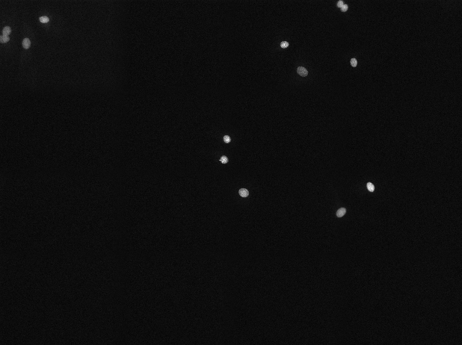
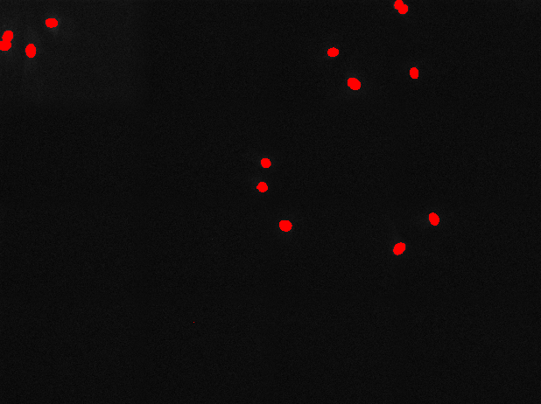
Thresholding
Pixel Intensity

Slide 36
One problem with this approach…
It’s biased towards brighter objects
Ideally would use second channel to independently define objects to measure

Slide 37
Binary images
Thresholding gives you a binary image; 1 inside an object, 0 elsewhere
This can be used to identify objects
It can also be manipulated

Slide 38
Binary operations: dilation and erosion
0 | 0 | 0 | 0 | 0 | 0 | 0
0 | 0 | 0 | 1 | 0 | 0 | 0
0 | 0 | 1 | 1 | 1 | 0 | 0
0 | 0 | 1 | 1 | 1 | 1 | 0
0 | 1 | 1 | 1 | 1 | 0 | 0
0 | 0 | 1 | 1 | 0 | 0 | 0
0 | 0 | 0 | 0 | 0 | 0 | 0
0 | 0 | 0 | 0 | 0 | 0 | 0
0 | 0 | 0 | 0 | 0 | 0 | 0
0 | 0 | 0 | 1 | 0 | 0 | 0
0 | 0 | 0 | 1 | 1 | 0 | 0
0 | 0 | 1 | 1 | 0 | 0 | 0
0 | 0 | 0 | 0 | 0 | 0 | 0
0 | 0 | 0 | 0 | 0 | 0 | 0
erode

Slide 39
Binary operations: dilation and erosion
0 | 0 | 0 | 0 | 0 | 0 | 0
0 | 0 | 0 | 1 | 0 | 0 | 0
0 | 0 | 1 | 1 | 1 | 0 | 0
0 | 0 | 1 | 1 | 1 | 1 | 0
0 | 1 | 1 | 1 | 1 | 0 | 0
0 | 0 | 1 | 1 | 0 | 0 | 0
0 | 0 | 0 | 0 | 0 | 0 | 0
0 | 0 | 0 | 1 | 0 | 0 | 0
0 | 0 | 1 | 1 | 1 | 0 | 0
0 | 1 | 1 | 1 | 1 | 1 | 0
0 | 1 | 1 | 1 | 1 | 1 | 1
1 | 1 | 1 | 1 | 1 | 1 | 0
0 | 1 | 1 | 1 | 1 | 0 | 0
0 | 0 | 1 | 1 | 0 | 0 | 0
dilate

Slide 40
Other binary operations
Sequential erosion and dilation – tends to smooth objects
Hole filling
Removing objects at borders

Slide 41
Further reading
Lectures available online: nic.ucsf.edu/edu.html
Gonzalez, Woods, and Eddins: Digital Image Processing (Using Matlab)
Pawley: Handbook of Biological Confocal Microscopy

